Slide 1
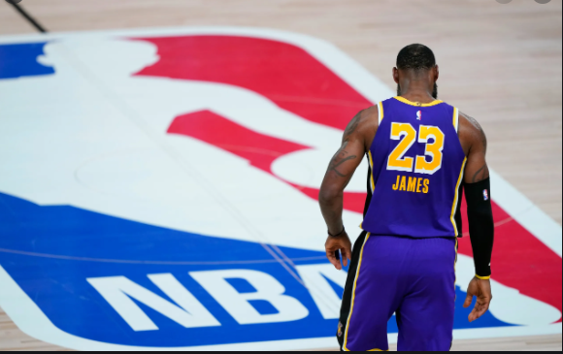
NBA PLAYER ANALYSIS
Submitted By-
Ali
Josh
Pierre
Karan

Slide 2
PROJECT OVERVIEW
Using machine learning to analyze player decline in the NBA. This analysis will aim to provide insight on the following questions:
Based on the player archetype, when will the athlete begin to experience a decline in performance?
Once the player has begun to decline, will adjusting the athletes playstyle help avoid regression?

Slide 3
STORYBOARD
Project overview and setting the hypothesis
Data Integration using PostgreSQL and ERD Diagram
Data Visualization
Data Collection and cleaning the data files
Machine Learning Model - Clustering the data using PCA model

Slide 4
DATA CLEANING
From Kaggle data set (Season Stats, Players, Player Data) ,we used Season Stats
Unwanted columns like Games Started and Position among others from Season Stats were dropped.
Removed data from before the 2003 season as the data set is from 1950-2018 and we want 2003-2018
Next, created join on players from the Players csv to get the height and weight.
Then, we created a new column - year the player is in, to get this we took the year stated column from Player Data and subtract that number form the year column in Season Stats
Lastly, we removed the duplicates from the team column, for when a player played on multiple teams in a year and keep the Total.
I.e., if a player plays on 2 teams, they would be shown 3 times, once with team 1, once with team 2 and once with Total, so we keep the total

Slide 5
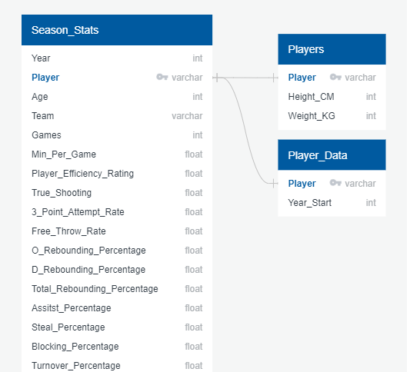
DATA INTEGRATION
NBA Player data was collected from Kaggle.
ERD diagram was created to display contents of data store and constructing a relational database.
Notes:
References - NBA.com - https://pypi.org/project/nba-api/#description
Kaggle - https://www.kaggle.com/drgilermo/nba-players-stats?select=player_data.csv-

Slide 6
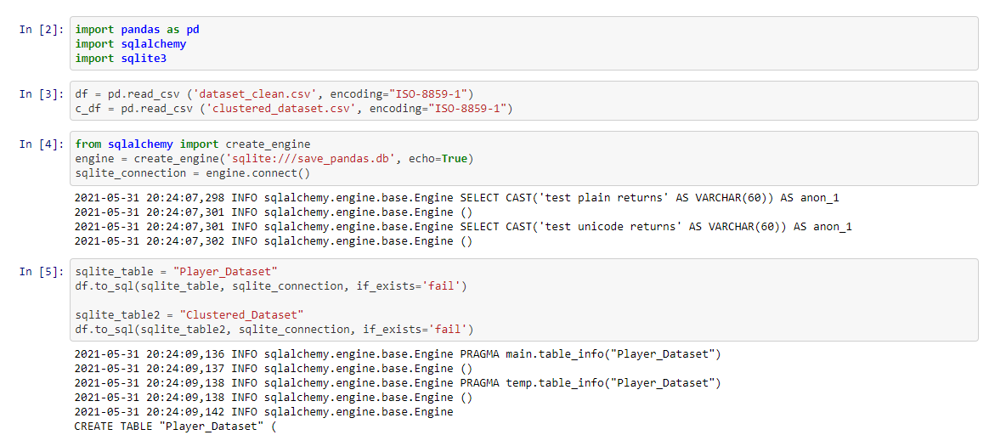
The project used SQLite with SQLAlchemy for the database integration.

Slide 7
MACHINE LEARNING
Primary Objective
Dataset is fed into PCA model to predict player regression based on archetype in NBA.
By looking into various studies, we determine that our chances to have greater accuracy would be by using clustering.
How are you training your model?
First cluster players using data into archetype each year
Cluster ONCE then assign each year based on years into career
Look at VORP to see when if they regress
VORP is value over replacement player basically how good a player was that season with a -2.0 being a replacement level player (really bad player)
Also look at if they change player type do they still regress
From the two references, we should have an accuracy between 75% and 85%
Notes:
References - Model 1: https://github.com/micahmelling/player_decline Article: https://www.baseballdatascience.com/machine-learning-to-predict-player-decline/
Model 2: https://towardsdatascience.com/redefining-nba-player-classifications-using-clustering-36a348fa54a8

Slide 8
How does this model work?
We will use a "voting classifier". It aggregate a logistic regression, adaptive boosting, gradient boosting, random forest, and extra trees.
The database in the schema (NBA_Analysis_ERD.png)
Filter to use the data from 2003 to 2018
For example, our dataset will include the year, is it his first year, salary, position (e.g. 3B) then each cluster will have parameters for each player.

Slide 9
DATA VISUALIZATION
Tableau will be used for data visualization -
https://public.tableau.com/app/profile/karanpreet8221/viz/NBAAnalysis_16223090479000/VORPbyPlayer
https://public.tableau.com/app/profile/karanpreet8221/viz/FinalResults_16225849830960/Finalresults
The dashboard is representing visuals that are answering the questions asked.
Player’s VORP is compared with their age, MP, age and years into the game to see what affects player’s performance the most.
Once player regression is determined, the final clustering helps us to determine if changing playerstyle actually helps in some players over the others.
Here are some of the visualizations-

Slide 10
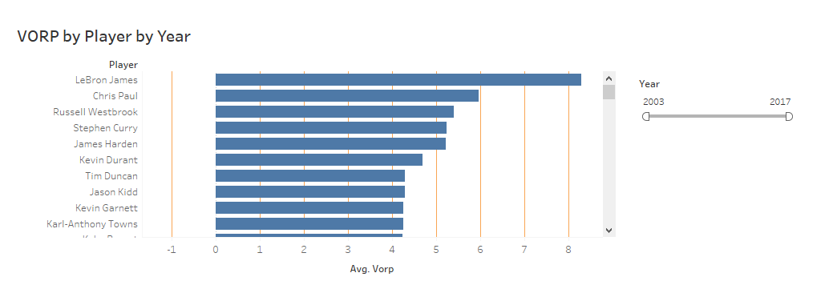
VORP by Player by Year

Slide 11
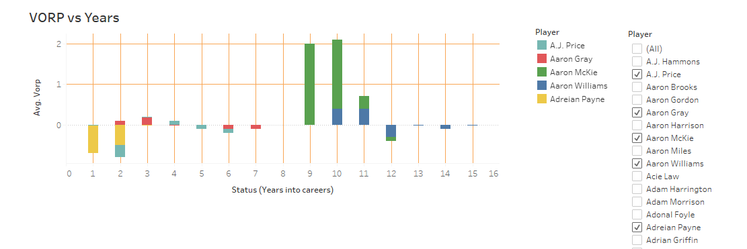

Slide 12
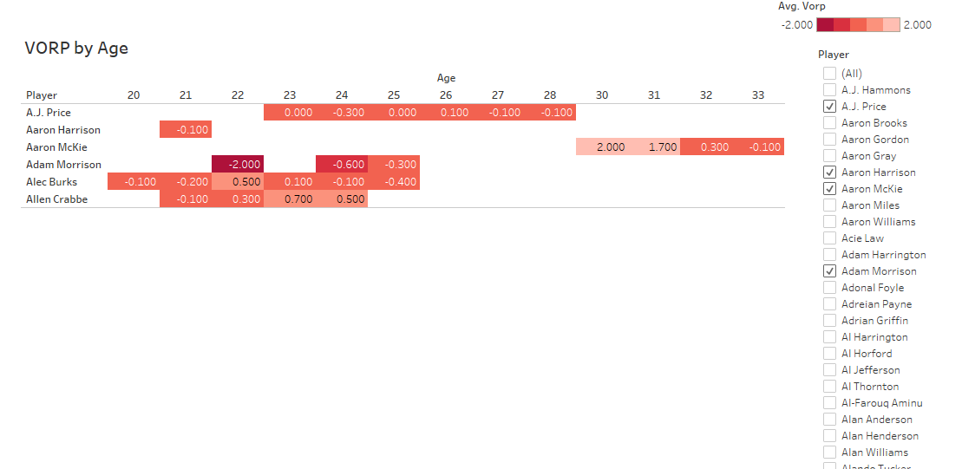
2. VORP by Age

Slide 13
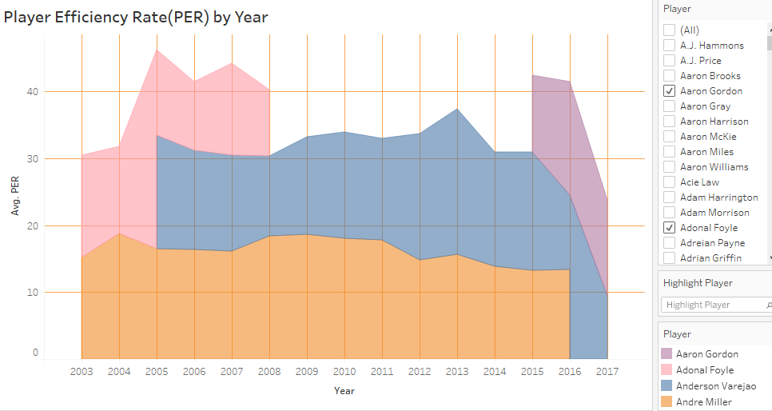
3. Player Efficiency Rate By Year

Slide 14
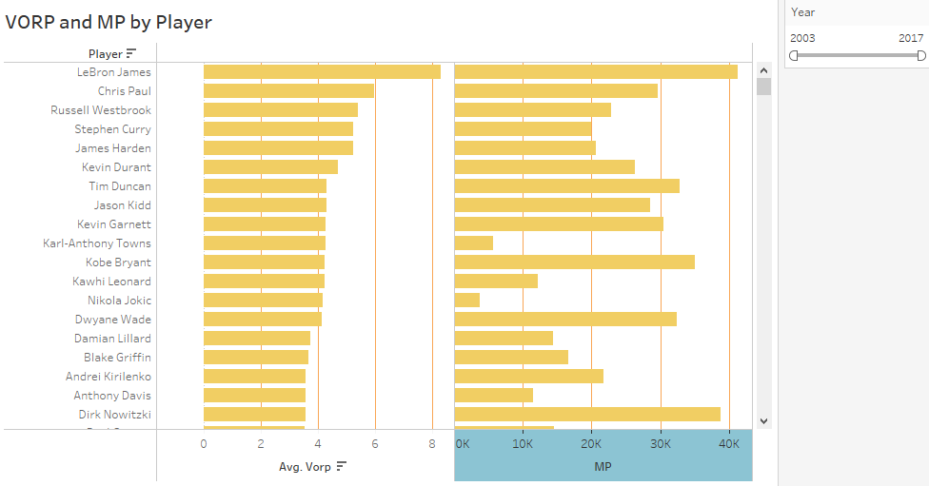
4. VORP by MP

Slide 15
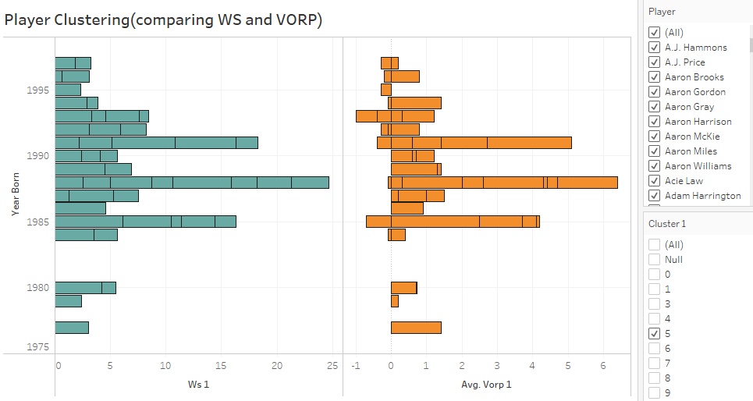
Clustering Results

Slide 16
REFERENCES
NBA.com - https://pypi.org/project/nba-api/#description
Kaggle - https://www.kaggle.com/drgilermo/nba-players-stats?select=player_data.csv-
Model 1: https://github.com/micahmelling/player_decline Article: https://www.baseballdatascience.com/machine-learning-to-predict-player-decline/
Model 2: https://towardsdatascience.com/redefining-nba-player-classifications-using-clustering-36a348fa54a8

